Slide 1

Let’s React
Urban Cvek
@urbancvek
git clone https://github.com/urbancvek/react-workshop.git

Slide 2
Agenda
na kratko o ES2015, ES2016, JSX
hello world (React.Props, React.Children)
data flow, komunikacija med komponentami (React.State)
navigacija (React Router)
CSS in JS (className, inline styles, aphrodite)
primer gradnje aplikacije za Spotify

Slide 3
ES@next
Vedno bolj zahtevne spletne aplikacije
Babel - Podpiranje starih brskalnikov
Nove funkcionalnosti (“syntactic sugar”)

Slide 4
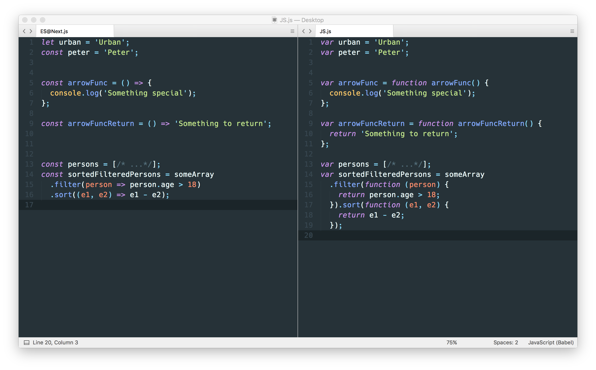
ES@next
variable declaration
arrow functions

Slide 5
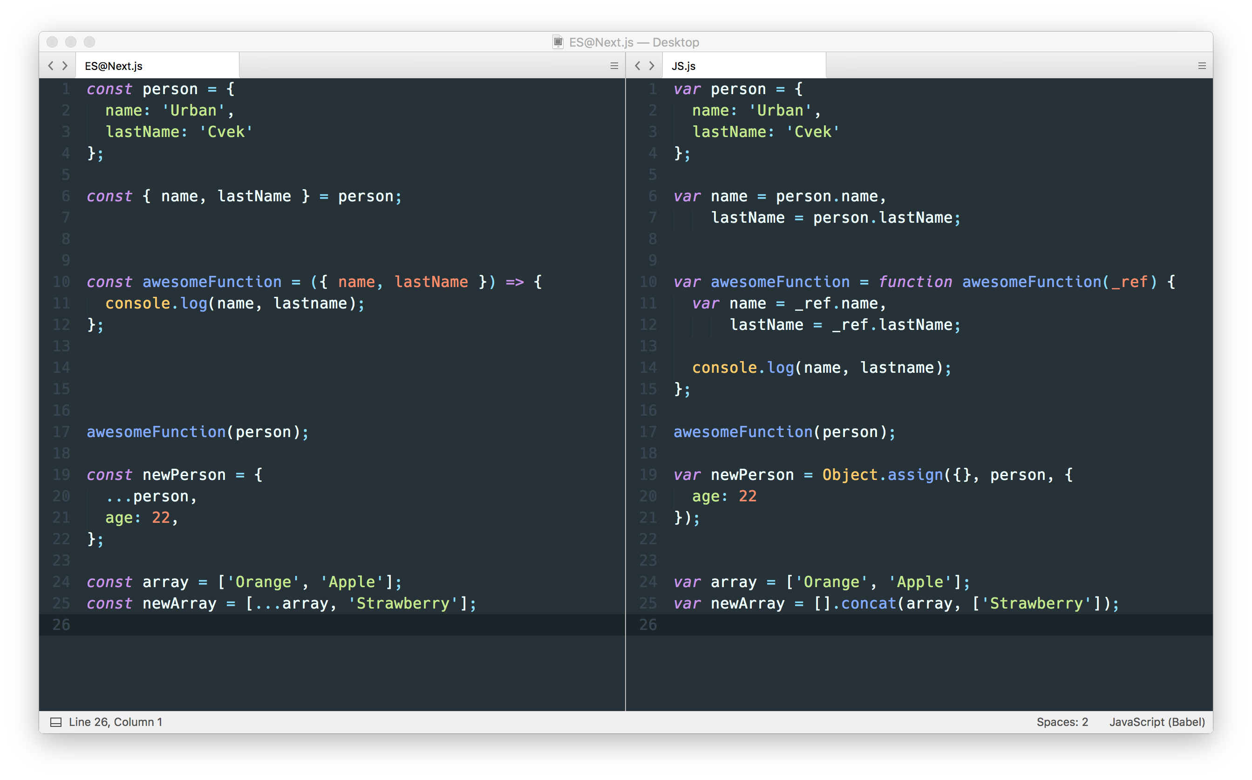
ES@next
object destructuring
destructuring assignment

Slide 6
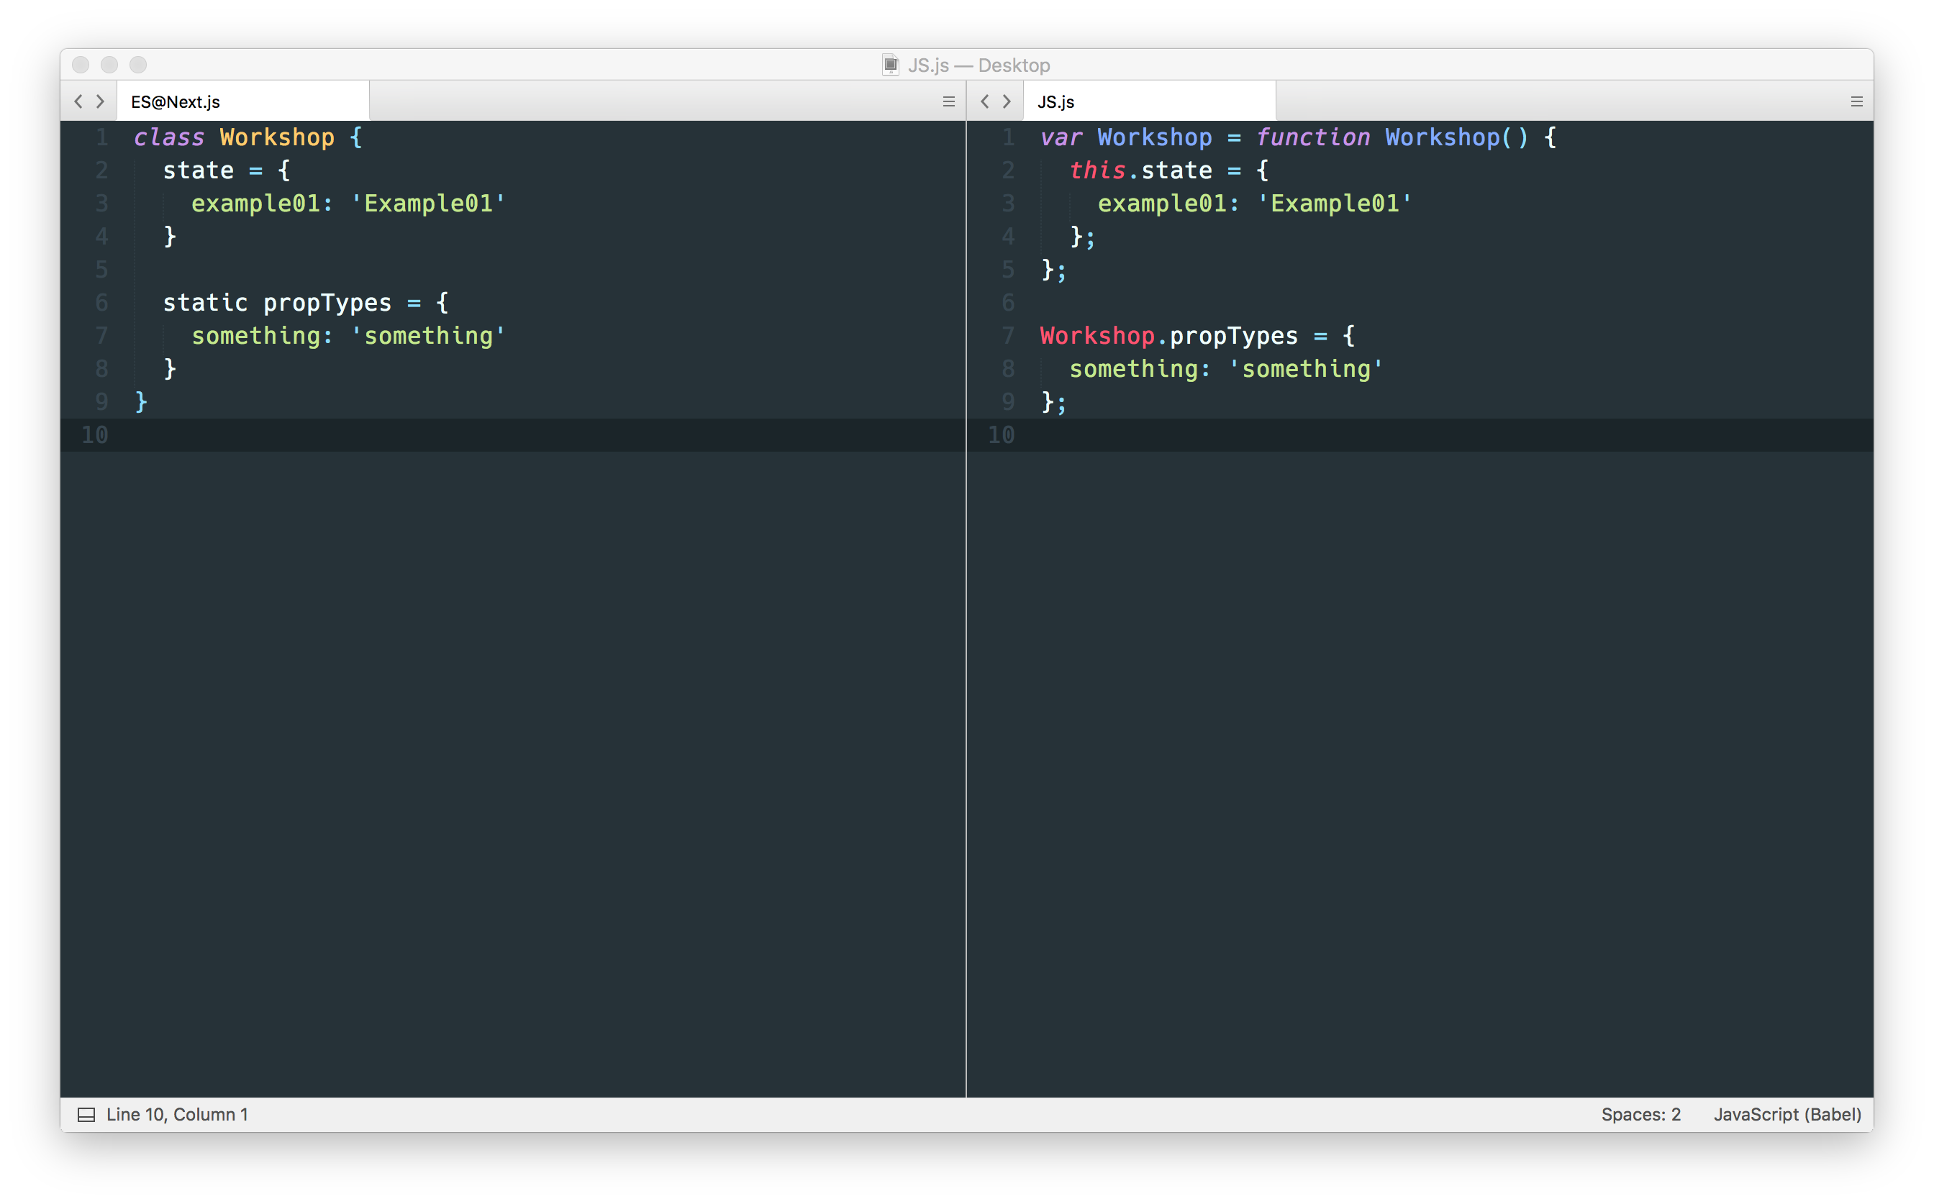
ES@next
classes

Slide 7
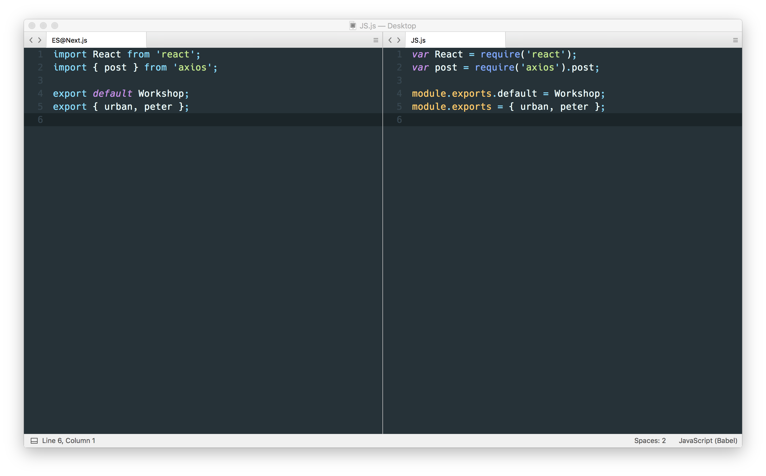
ES@next
modules

Slide 8
JSX
XML v Javascript
Vedno en “root” element

Slide 9
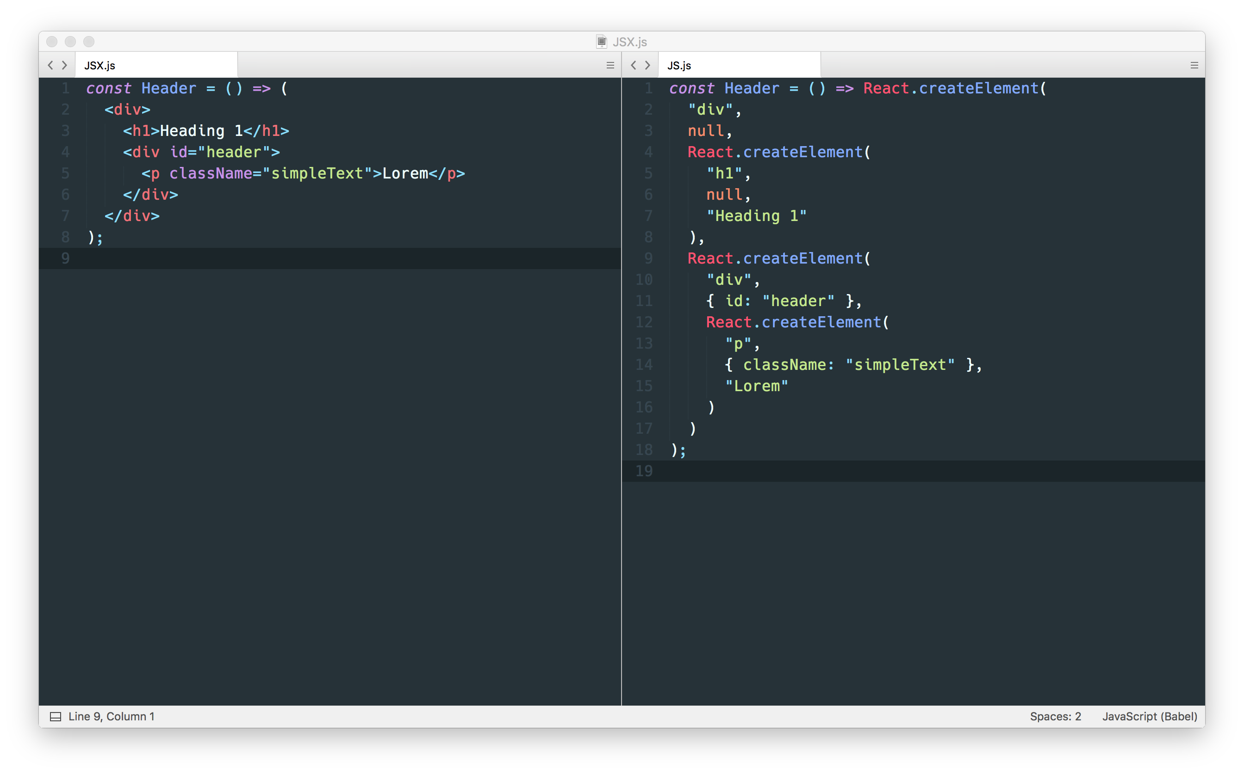
JSX

Slide 10
React
“View” v “MVC” modelu
Ne potrebuje DOM-a (deluje na serverju)
React(podatki) => VirtualDOM
Virtual DOM
čim manj interakcij z DOM-om
elementi predstavljeni kot objekti

Slide 11
Hello World Example
<HelloProps />
<HelloChildren />
props
props
firstName: string
lastName: string
children: ?any

Slide 12
Click Counter Example
<ClickCounter />
state
timesClicked: number

Slide 13
Stopwatch Example
<Stopwatch />
state
time: number
isRunning: boolean
timer: ?any

Slide 14
Form Example
<Form />
state
firstName: string
email: string
age: string

Slide 15
API Example
types
PokemonType: {
name: string
image: string
weight: number
xp: number
}
<PokeList />
props
state
pokemons: Array<string>
pokemons: Array<PokemonType>
<PokeDisplay />
<PokeDisplay />
<PokeDisplay />
props
props
props
pokemon: PokemonType
pokemon: PokemonType
pokemon: PokemonType

Slide 16
React Router Example
<Navbar />
<Route />
<Route />
props
props
exact?: boolean
path: string
component: ReactComponent
path: string
component: ReactComponent

